Slide 1
Introduction to the Ex Libris developer network and Alma APIs
Yoel Kortick. Senior Librarian

Slide 2
Introduction
Documentation
Creating and Managing API Keys
The API Console
API Usage Reports
Blog Posts

Slide 3
Introduction
Ex Libris is committed to an open platform, which includes support for integrations via open standards and REST APIs.
This support enables institutions to integrate Ex Libris solutions with local systems, create innovative services, increase the value of the library, and help meet the institution’s goals and objectives.

Slide 4
Introduction
The Developer Network is the one-stop shop for system librarians, developers, and IT engineers.
Here you can view documentation related to all Ex Libris products, read about successful integrations in the blog, ask a question on the forum, and manage your own usage of Ex Libris APIs.

Slide 5
Introduction
The Developer Network is open to everyone.
Each user can view all of the content without an account, and even try out Alma and Primo APIs in the API Console.
To create a blog post or ask a question on the forum, you can create an account for yourself.
If you’re already an Ex Libris customer, your institution was provided credentials to the Developer Network which allow you to create API keys which give you access to your institution’s environments.

Slide 6
Introduction
As of January 2019 the Ex Libris Developers Network has been fully updated.
The changes include, but are not limited to:
  Updated responsiveness
  Mobile-friendly design
  New API Console
  Redesigned API Key management
  API Usage reports
  Enhanced sharing platform-blog and forum

Slide 7
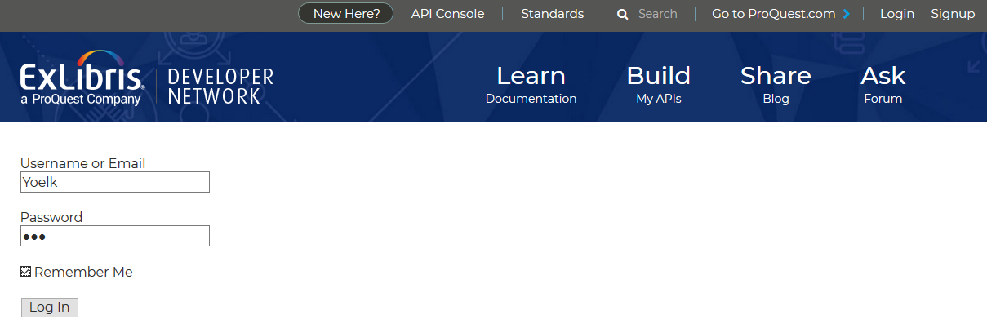
Introduction
Here we log in with credentials provided to the institution.

Slide 8
Documentation

Slide 9
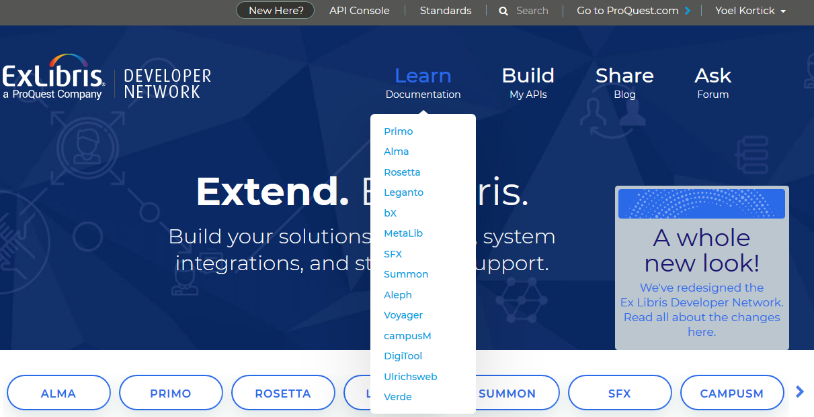
Documentation
Choose desired area of documentation

Slide 10
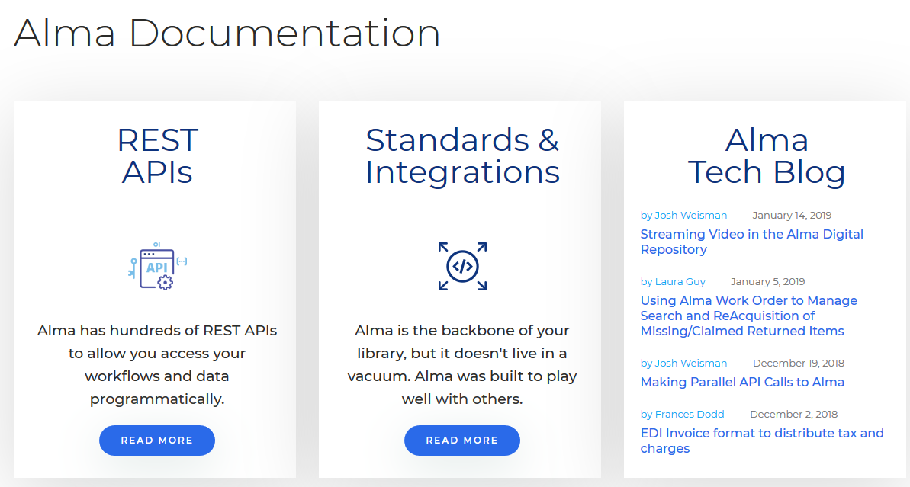
Documentation
Choose desired sub-area of documentation

Slide 11
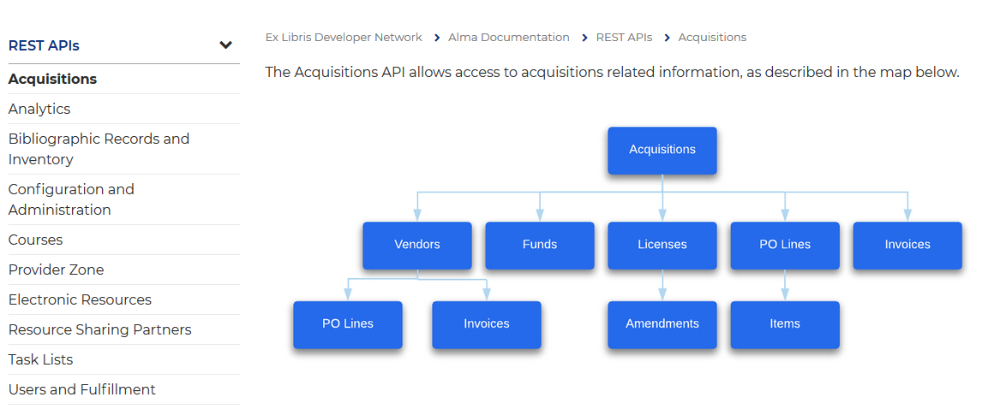
Documentation
Continue navigating

Slide 12
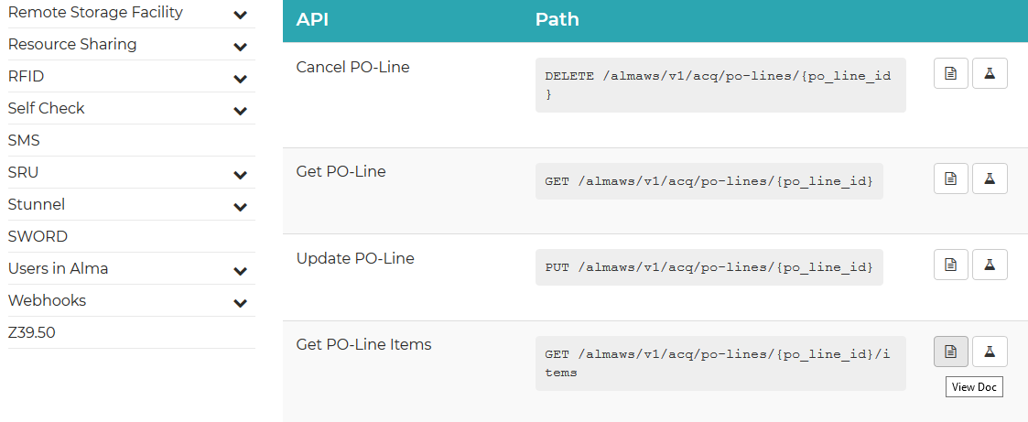
Documentation
Navigate to further in-depth documentation

Slide 13
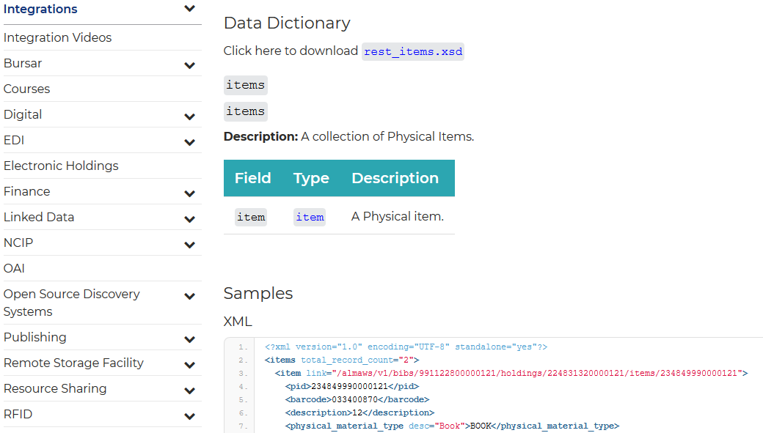
Documentation
View the more in-depth documentation

Slide 14
Documentation
The documentation also links to details of Standards and Integrations

Slide 15
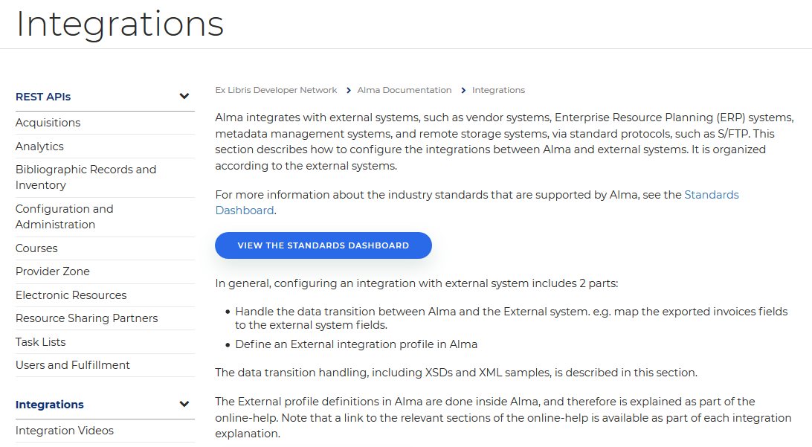
Documentation
This includes a Standards Dashboard

Slide 16
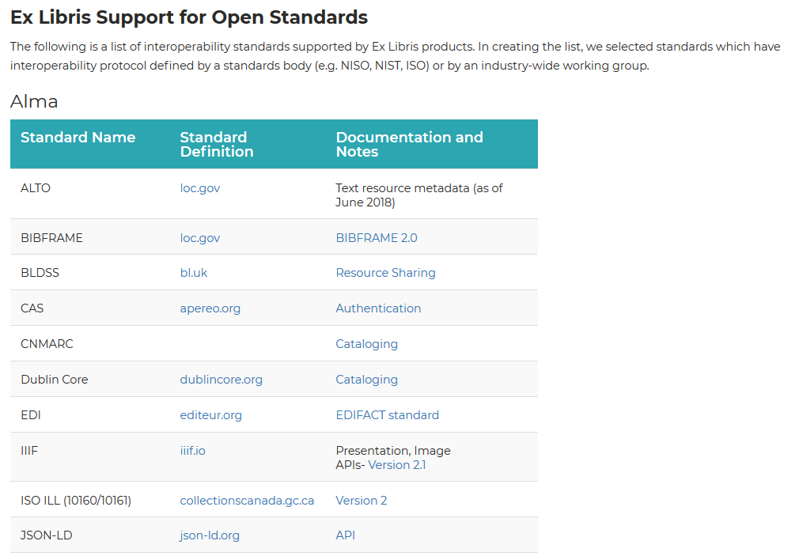
Documentation
The Standards Dashboard

Slide 17
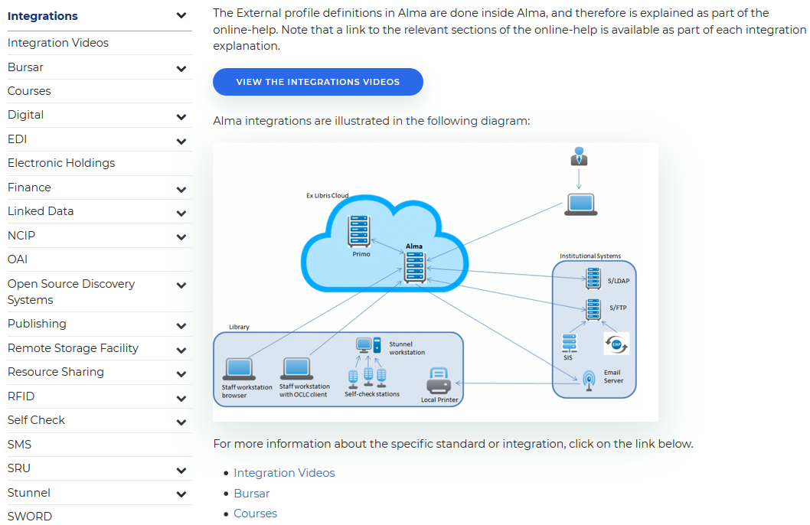
Documentation
There are also several links to specific Integrations

Slide 18
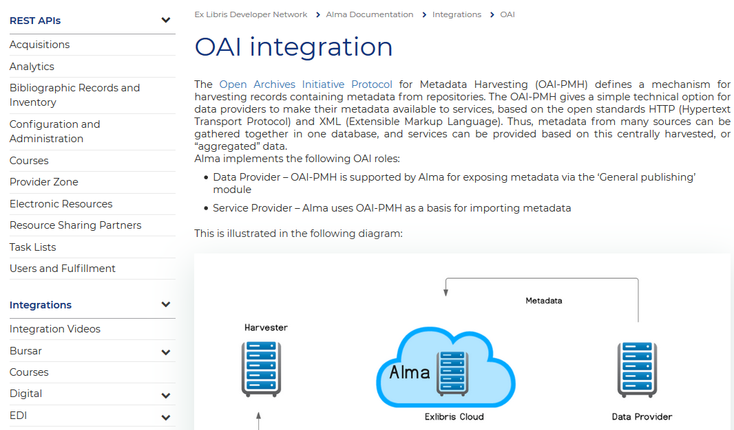
Documentation
Here for example is the link to the OAI Integration

Slide 19
Documentation
The documentation also includes blogs written by staff of both Ex Libris as well as live institutions (more later on creating blog posts)

Slide 20
Creating and Managing API Keys

Slide 21
Creating and Managing API Keys
In order to run an API an appropriate API key must be used
The API key can
  Point to the sandbox or production environment
  Be designed for read only or for read/write
Each API key relates to one or more general areas, such as Acquisitions, Analytics, Configuration, Courses, etc.
In this way when API keys are given to third party vendors for integration purposes, the institution can control
  Which data can be accessed
  If the data can be only retrieved (GET) or also deleted, created and updated (DELETE, PUT and POST).

Slide 22
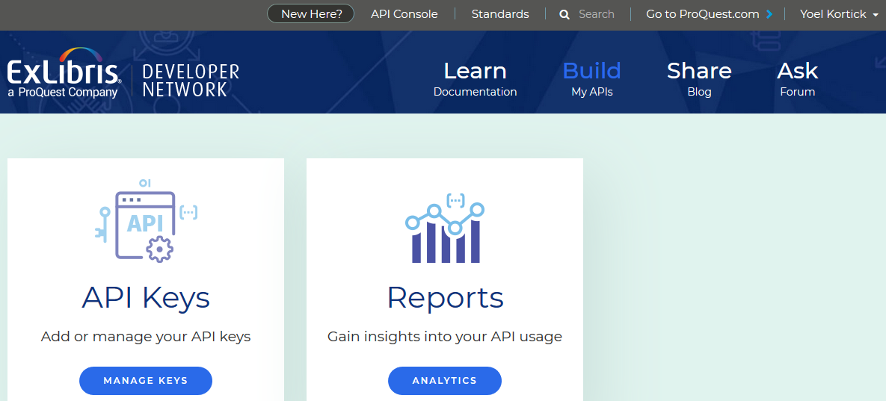
Creating and Managing API Keys

Slide 23
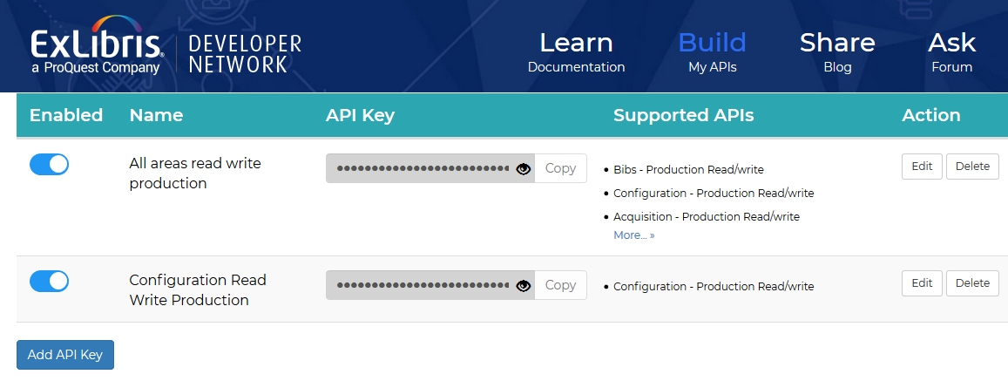
Creating and Managing API Keys
Now we will create an API key for acquisitions activities for read and write in the production environment.

Slide 24
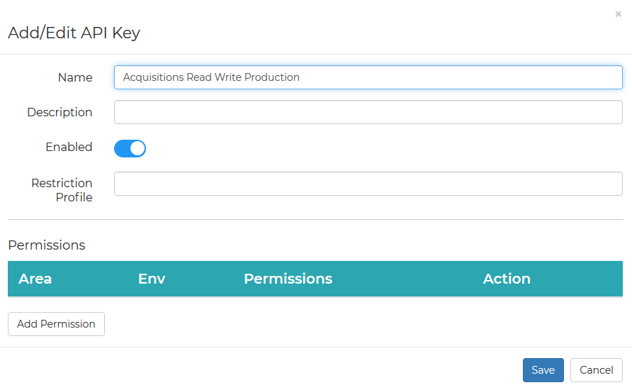
Creating and Managing API Keys
We have given the API key a name and now we will add permissions

Slide 25
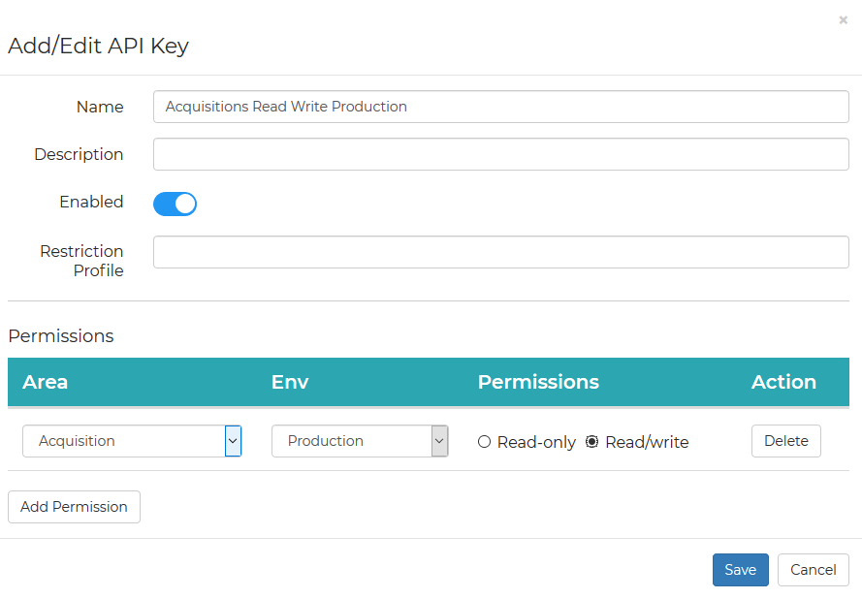
Creating and Managing API Keys
We have acquisitions for production with Read/Write permissions

Slide 26
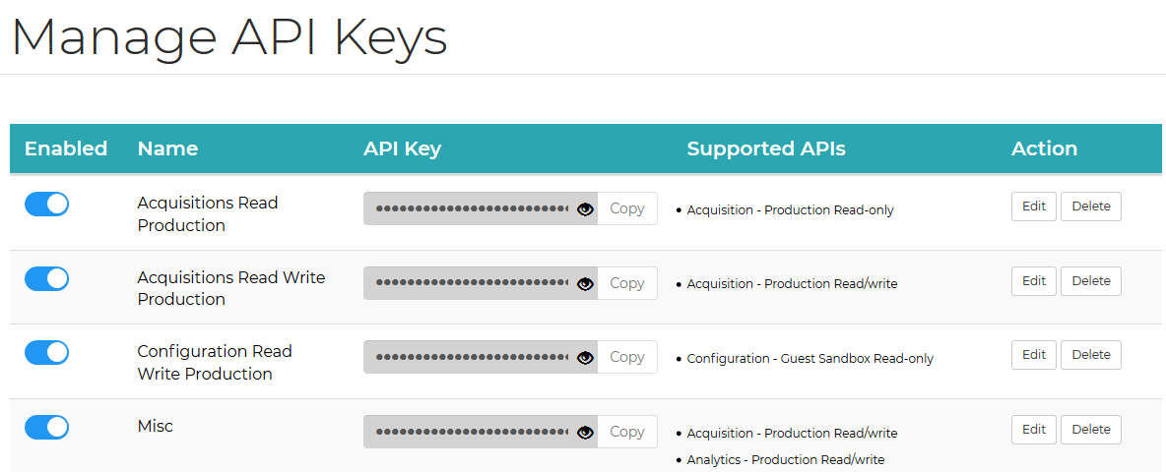
Creating and Managing API Keys
Now the new API Key appears in the list
In a moment we will use this new API key in the API console

Slide 27
Creating and Managing API Keys
As we can see it is not possible to see what the API key is. This is for security purposes.

Slide 28
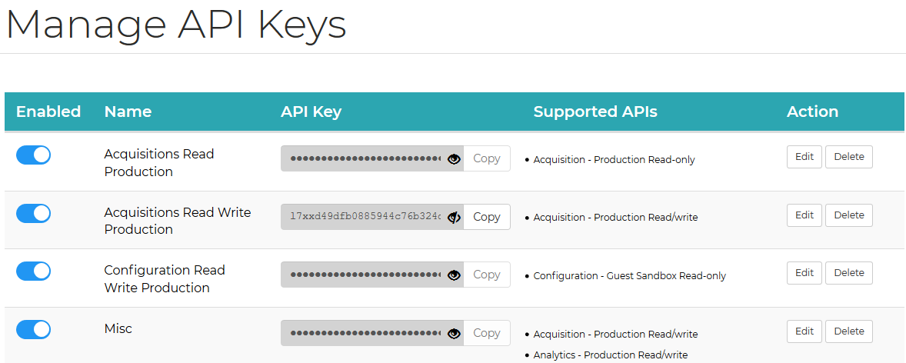
Creating and Managing API Keys
It is possible however to click the eye icon next to the API key and then view it and copy it.

Slide 29
The API Console

Slide 30
The API Console
The API Console can be used to run APIs and includes sample input (payload) data as well as built in links to the interactive documentation.
In this way it is not necessary to switch back and forth between the API documentation and a REST client because all is together in one convenient location

Slide 31
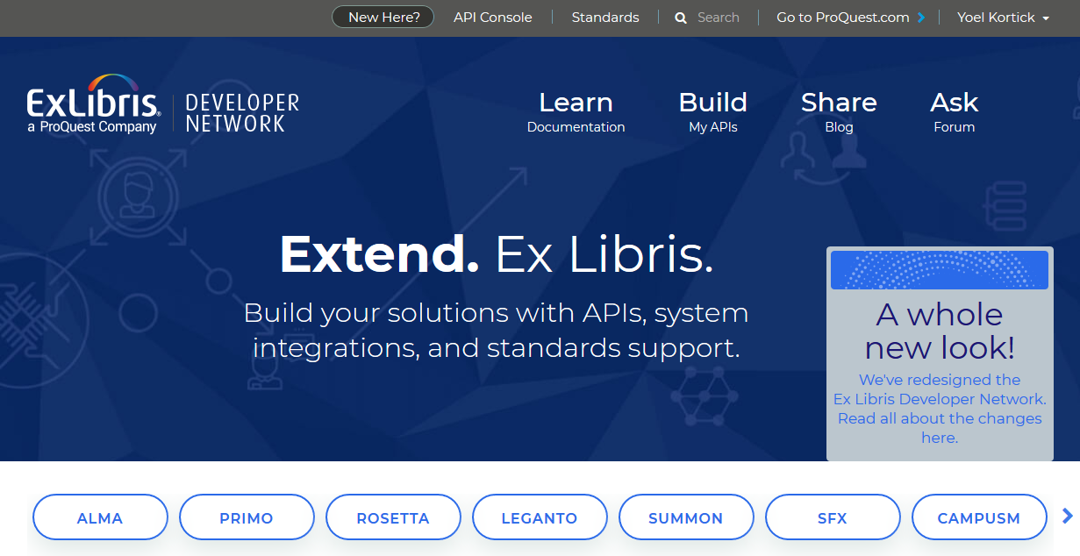
The API Console

Slide 32
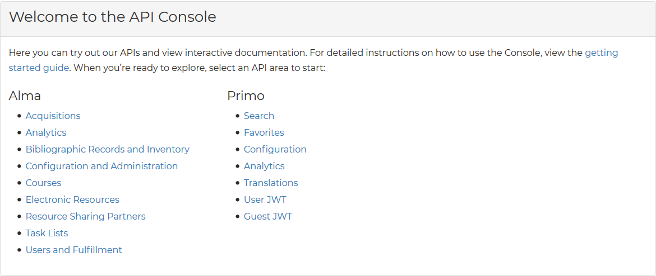
The API Console
Choose the API area in which you want to work

Slide 33
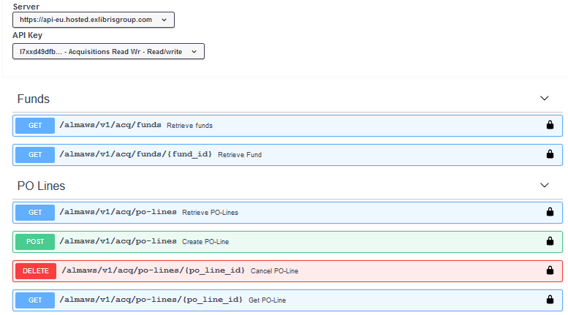
The API Console
Select API Key and specific API
The API key we made a moment ago

Slide 34
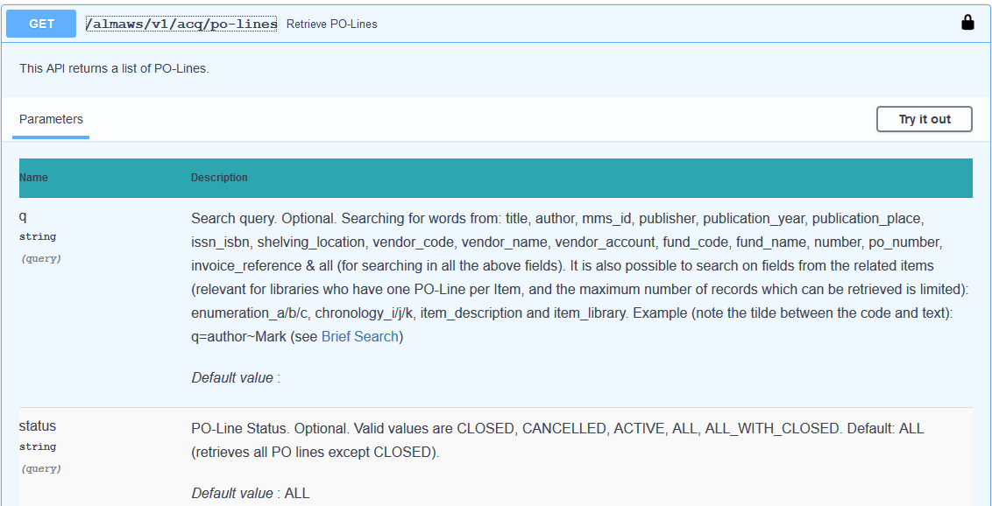
The API Console
View the syntax, read the documentation, and "Try it out"

Slide 35
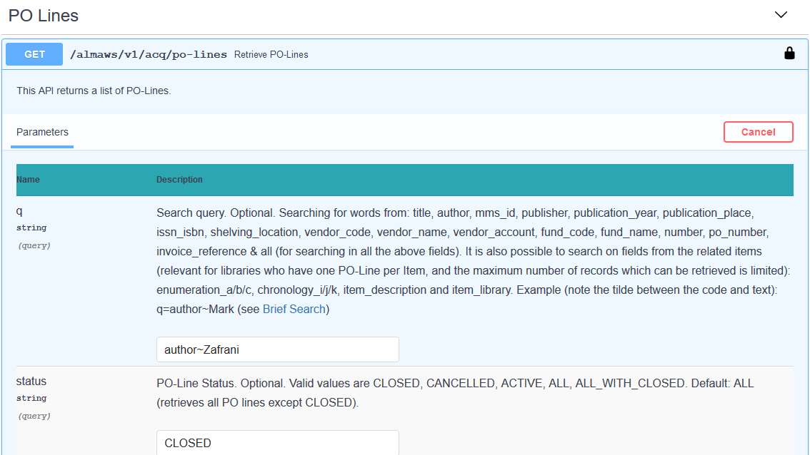
The API Console
Here we "Try it out"

Slide 36
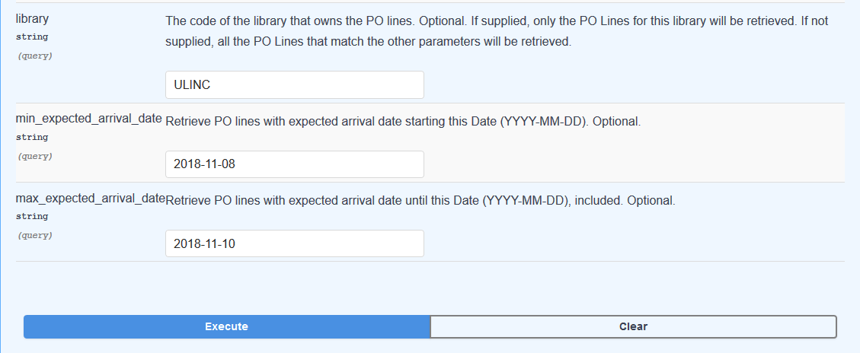
The API Console
And "Execute"

Slide 37
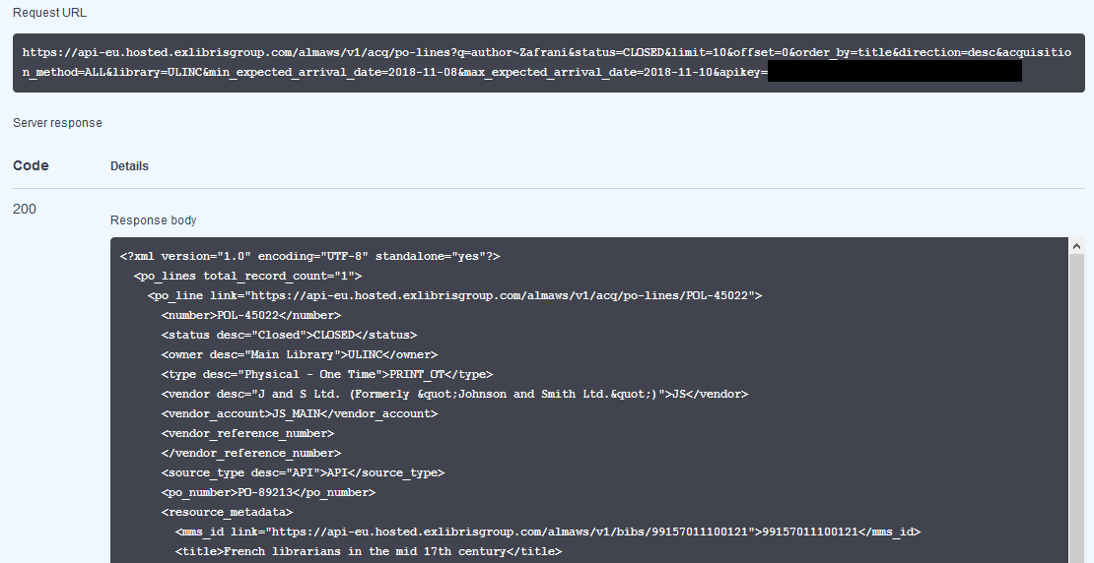
The API Console
View results as well as syntax

Slide 38
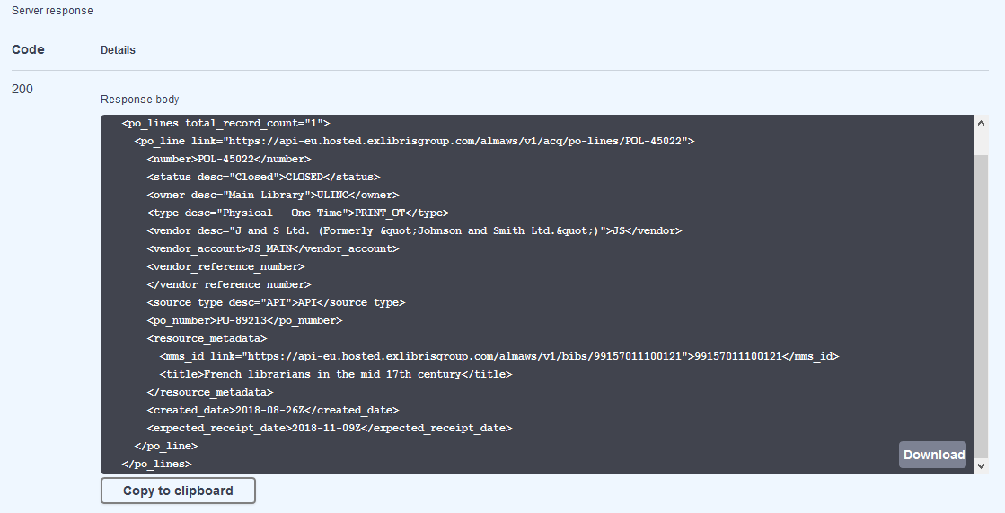
The API Console
The response body can be copied to clipboard or downloaded to a file

Slide 39
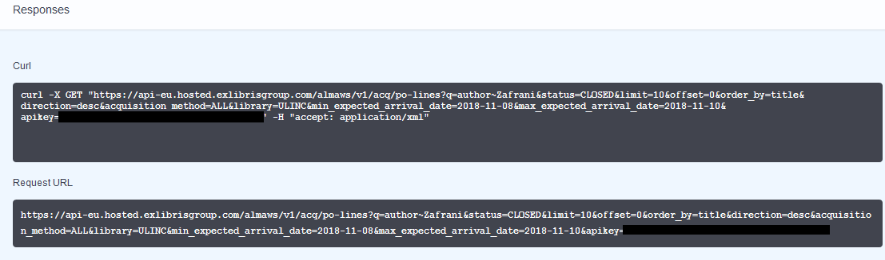
The API Console
The Curl or Request URL can be used as syntax for the application with which the institution is integrating.

Slide 40
The API Console
As seen in the API Console and from any application running APIs, Alma returns useful and helpful error messages
In the next slide the staff user is checking how APIs are used to retrieved Purchase Requests.
The staff user is trying to retrieve purchase request by status "approved" but "by accident" as entered "aproved" (with one "p") instead of "approved".

Slide 41
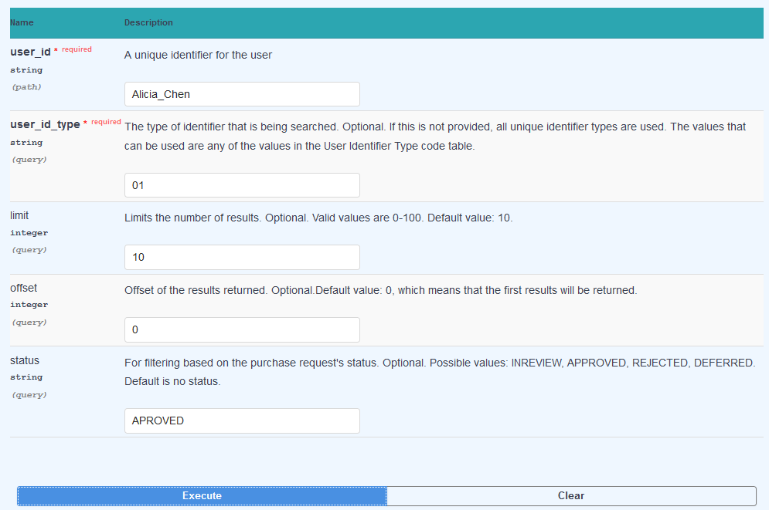
The API Console
A parameter error in the API syntax

Slide 42
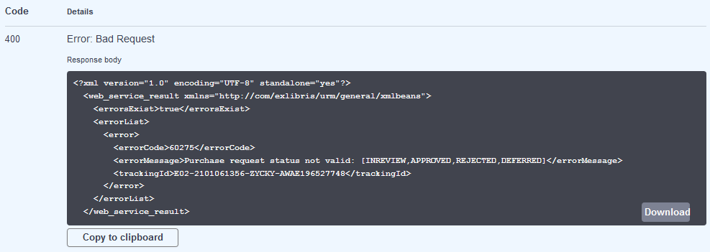
The API Console
The server response of type 400 does not merely state that there is an error but also states exactly where the error is and what the valid options are

Slide 43
The API Console
When creating data in the API console, for example a bibliographic record via POST, the API console both
  Includes a link to documentation describing the input (payload)
  Provides a sample input on the page of the API console to run the API

Slide 44
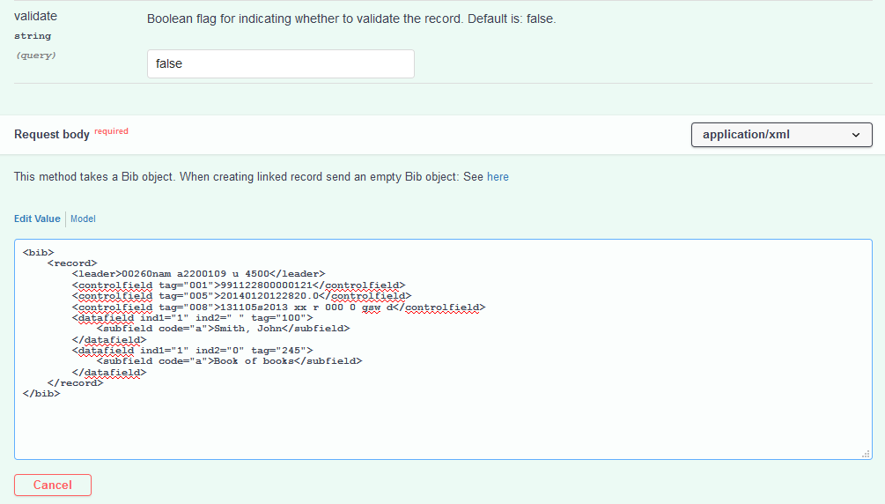
The API Console
Link to documentation explaining input
Sample input

Slide 45
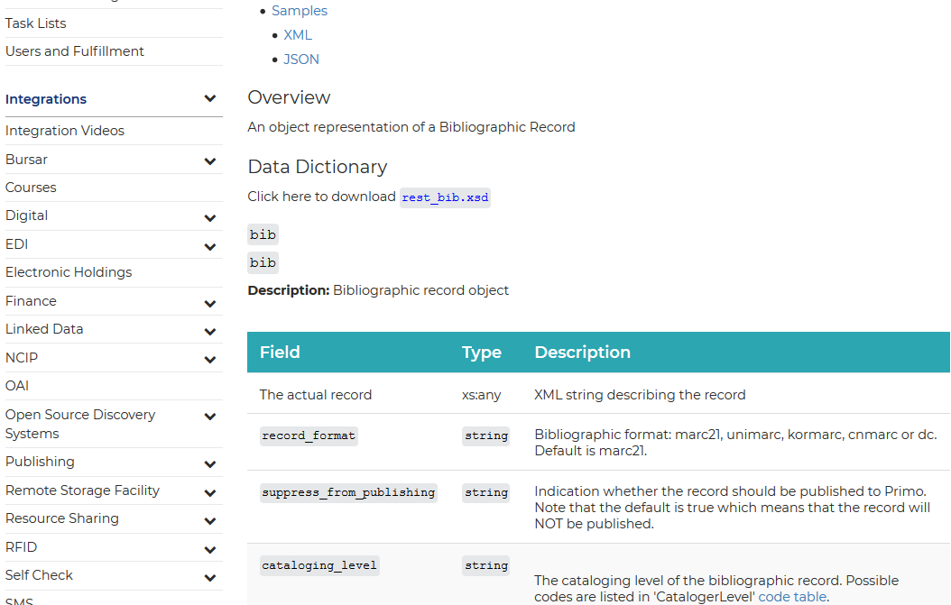
The API Console
For example in this case the link to documentation arrives here

Slide 46
The API Console
The staff user has decided to run the API to create the bibliographic record and use his own input based on the sample input already in the API console.
<bib>
<record>
<leader>00260nam a2200109 u 4500</leader>
<controlfield tag="005">20190120122820.0</controlfield>
<controlfield tag="008">131105s2019 xx r 000 0 gsw d</controlfield>
<datafield ind1="1" ind2=" " tag="100">
<subfield code="a">Zafrani, Elia</subfield>
</datafield>
<datafield ind1="1" ind2="0" tag="245">
<subfield code="a">French women entrepreneurs in the information industry</subfield>
</datafield>
<datafield ind1=" " ind2="1" tag="264">
<subfield code="a">Dimona</subfield>
<subfield code="b">Dimona Press</subfield>
<subfield code="c">2019</subfield>
</datafield>
<datafield ind1=" " ind2="0" tag="650">
<subfield code="a">Businesswomen</subfield>
<subfield code="z">France</subfield>
<subfield code="v">Case studies</subfield>
</datafield>
<datafield ind1=" " ind2="0" tag="650">
<subfield code="a">Women-owned business enterprises</subfield>
<subfield code="z">France</subfield>
<subfield code="v">Case studies</subfield>
</datafield>
<datafield ind1=" " ind2="0" tag="650">
<subfield code="a">Entrepreneurship</subfield>
<subfield code="z">France</subfield>
<subfield code="v">Case studies</subfield>
</datafield>
</record>
</bib>

Slide 47
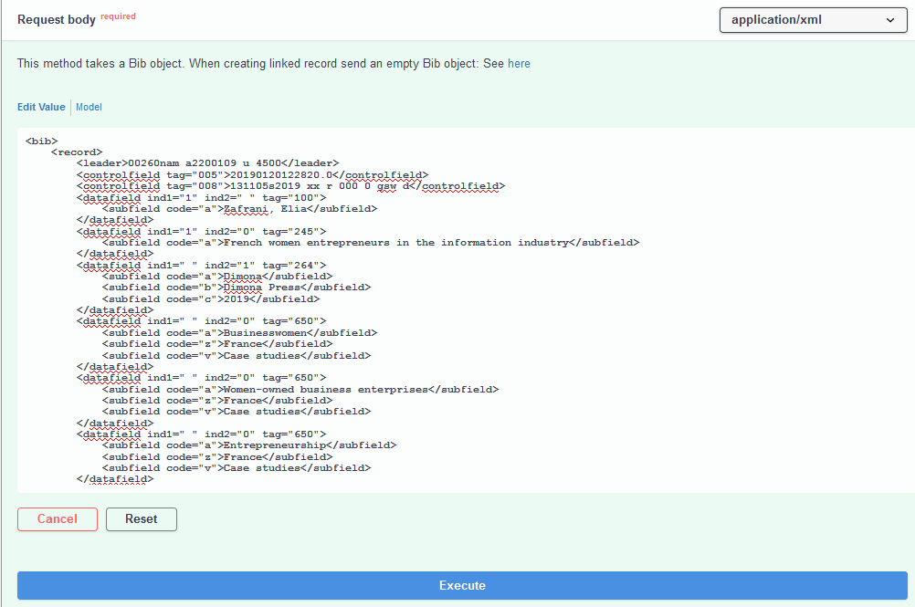
The API Console

Slide 48
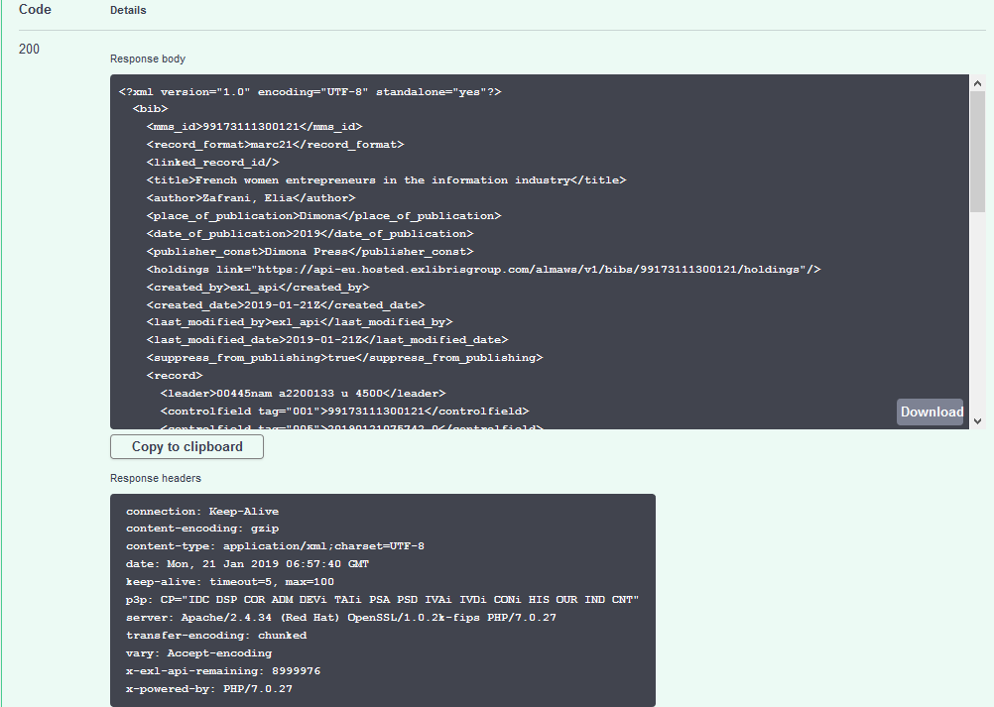
The API Console
We see in the response that the record is created and gets an MMSID

Slide 49
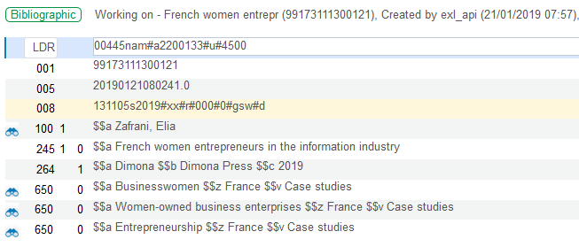
The API Console
In Alma we see that the record was created by the API

Slide 50
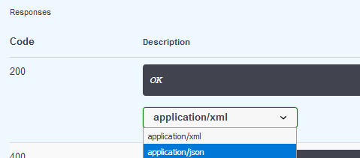
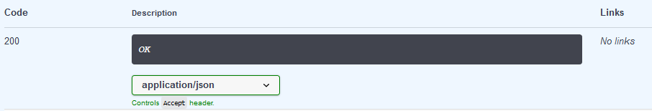
The API Console
While the default is for the API Console to return data in xml, it is also possible to define that the data will be returned in json format

Slide 51
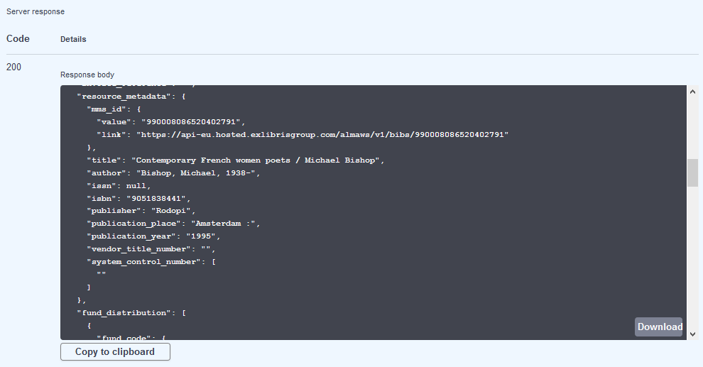
The API Console
Here for example we have retrieved a POL in json format

Slide 52
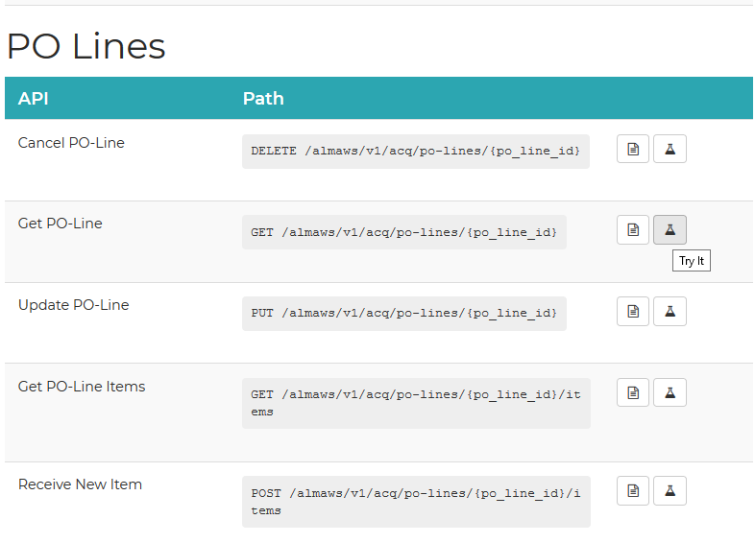
The API Console
Note also that from within the documentation section of the Developer Network it is possible to access the API console via the "Try It" link

Slide 53
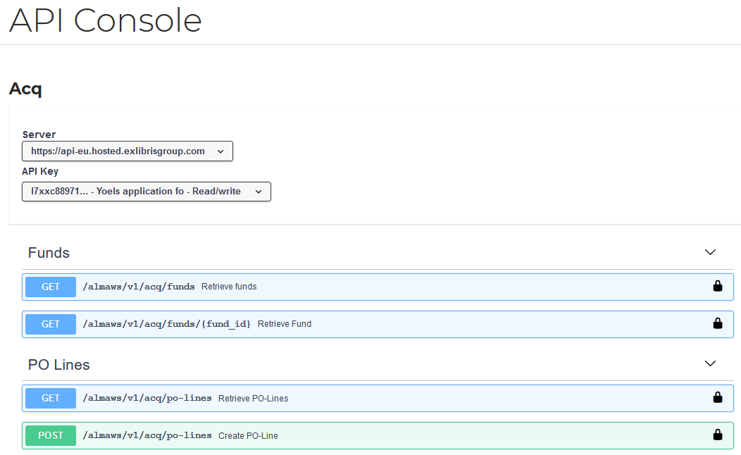
The API Console
After clicking the "Try It" the user will arrive to the API console in the area from which he came (in this case Acquisitions)

Slide 54
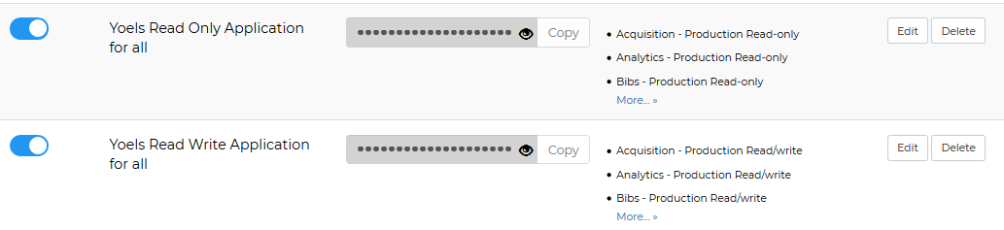
The API Console
Further, note that in the API Console the options for which APIs run depend on the permissions of the API key chosen
For example, here we have two API keys, one which allows for read only and one which allows for full read/write

Slide 55
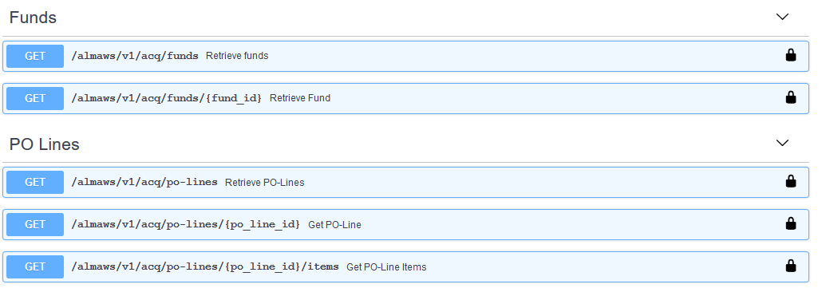
The API Console
When choosing the read only API in the API console we see only GET APIs

Slide 56
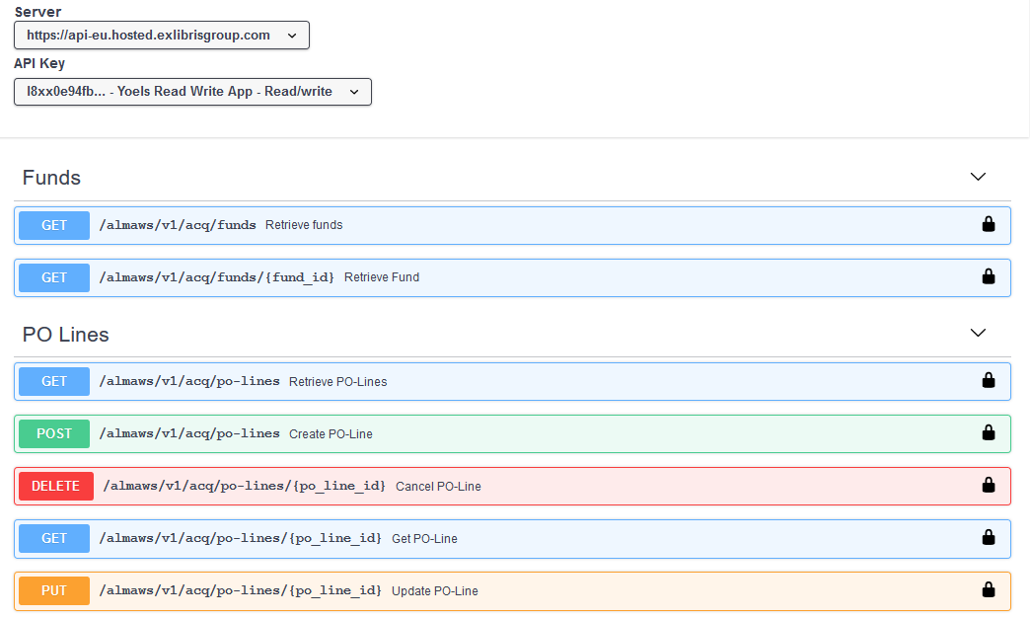
The API Console
When choosing the read/write API in the API console we see GET, PUT, POST and DELETE APIs

Slide 57
API Usage Reports

Slide 58
API Usage Reports
Each institution can gain insight into their API usage via built in analytics reports.
These reports may be accessed via "Build my APIs > Reports Analytics"

Slide 59
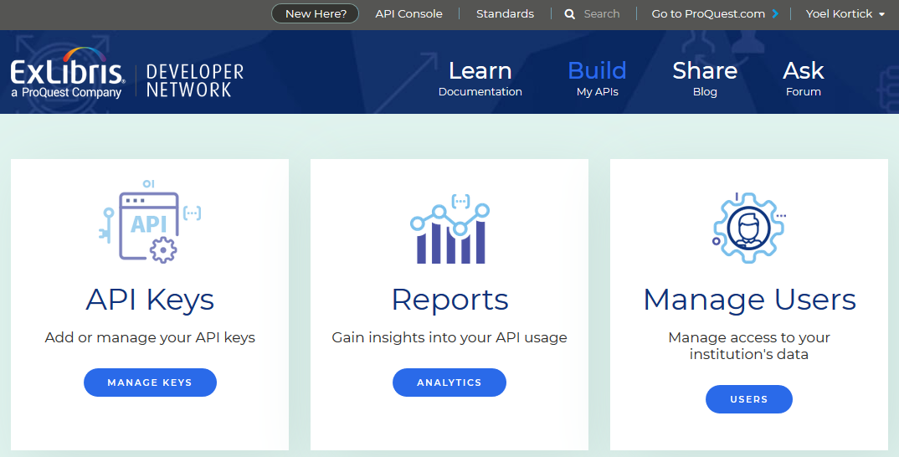
API Usage Reports

Slide 60
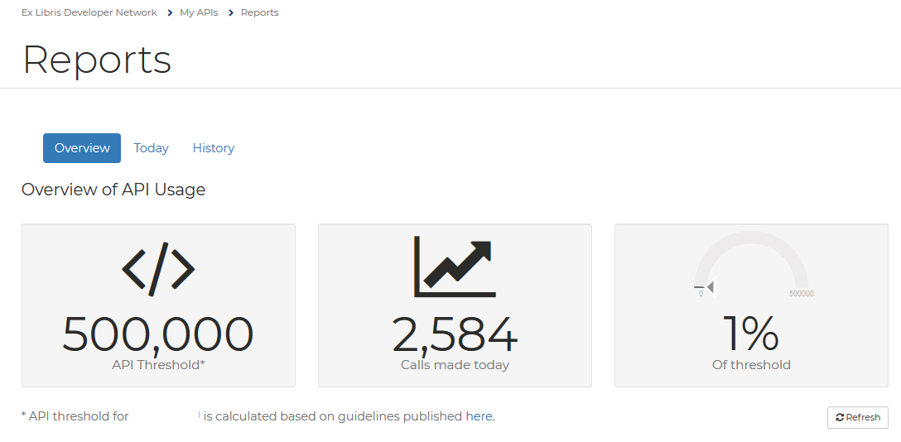
API Usage Reports
The default page shows an overview of APIs run the same day and how much percentage this is of the threshold
Link to description of the threshold

Slide 61
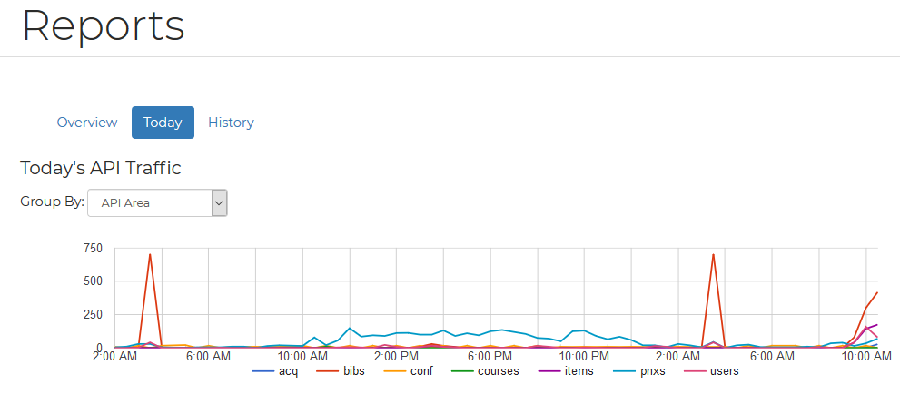
API Usage Reports
It is also possible to see details reports of "today" or "history"

Slide 62
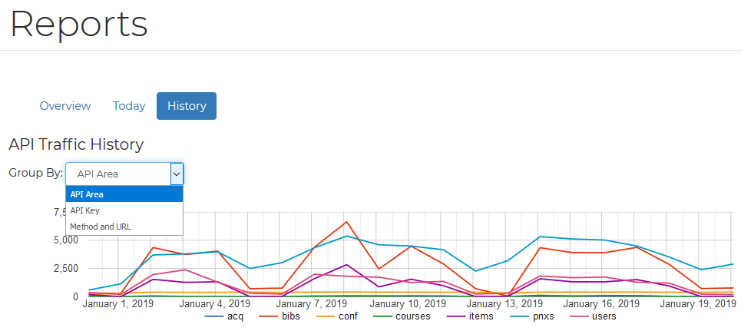
API Usage Reports
The reports can be grouped by:
  API Area
  API Key
  Method and URL

Slide 63
Blog Posts

Slide 64
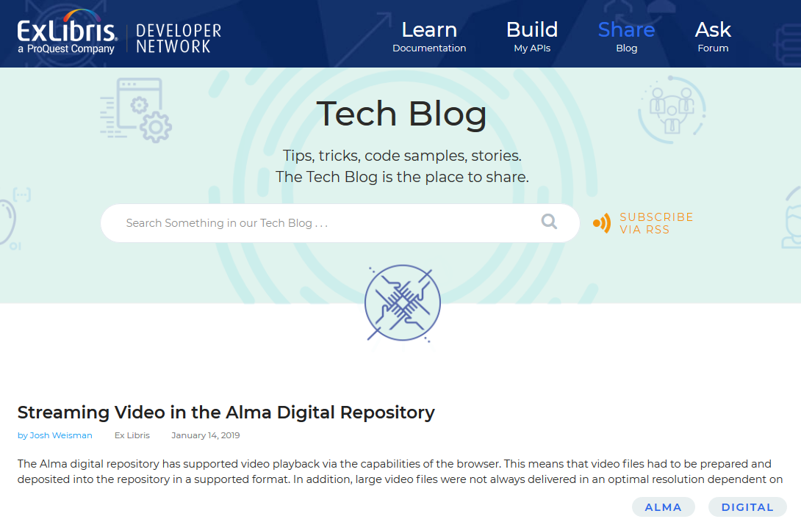
Blog Posts
Blogs from both Ex Libris staff as well as staff of libraries may be accessed via the "Share Blog" link (below) as well as the "Learn Documentation" link (as previously seen).

Slide 65
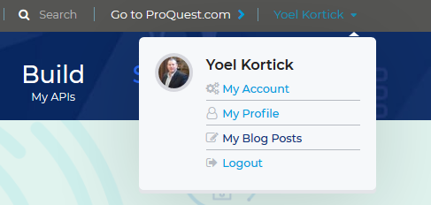
Blog Posts
Blogs may be added (and later edited) by accessing "My Blog Posts" and then "Create a blog post"

Slide 66
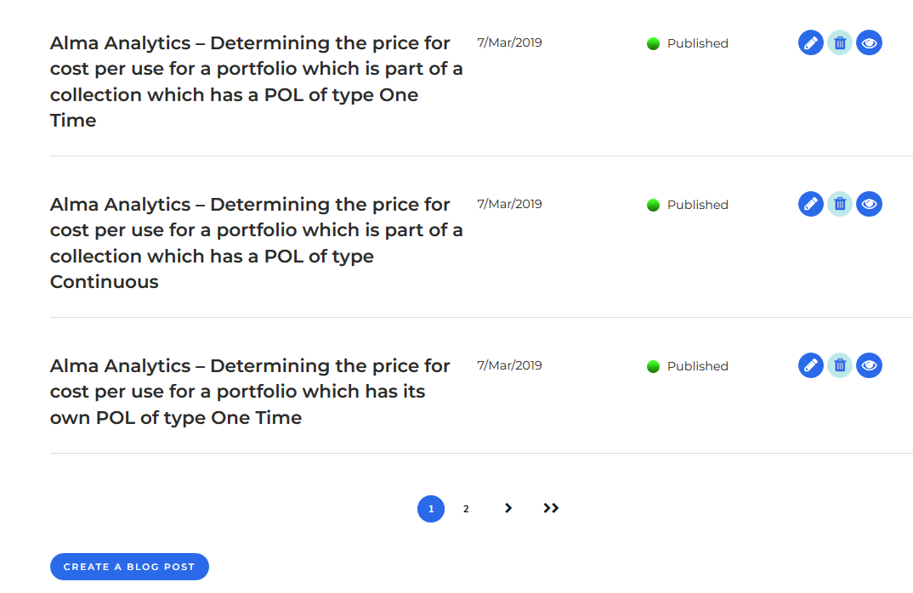
Blog Posts

Slide 67
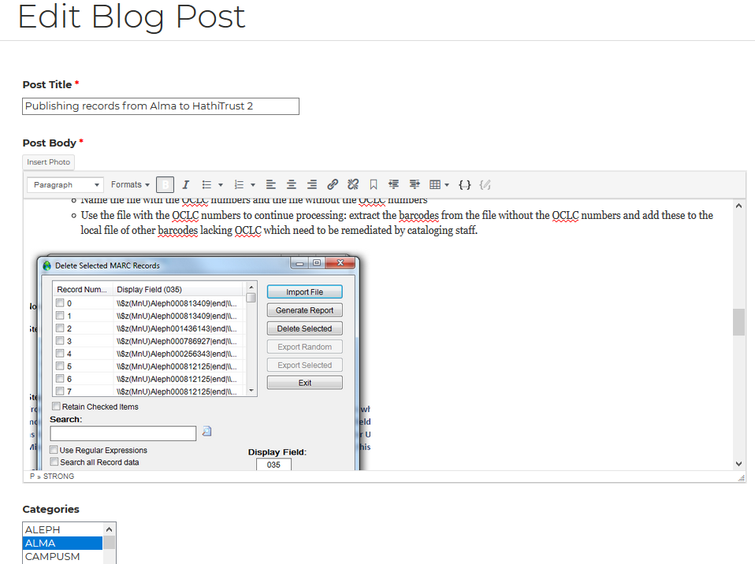
Blog Posts
The page for creating and editing a blog features an easy to use and intuitive interface

Slide 68
Yoel.Kortick@exlibrisgroup.com

